Slide 1
Griha Suraksha
Team Members
Abhishek
Anil
Navya
Praveen
Vikram
Lokesh
Albin

Slide 2
Home Insurance management Introduction
Home insurance is a service that protects your house and belongings from damage or loss due to events like fire, theft, natural disasters, or accidents. If something bad happens, the insurance company helps you pay for the repairs or replacements.
Different Types of Home Insurance Polices
Policy issuance
Premium calculation
Claim processing
Customer communication
Risk evaluation

Slide 3
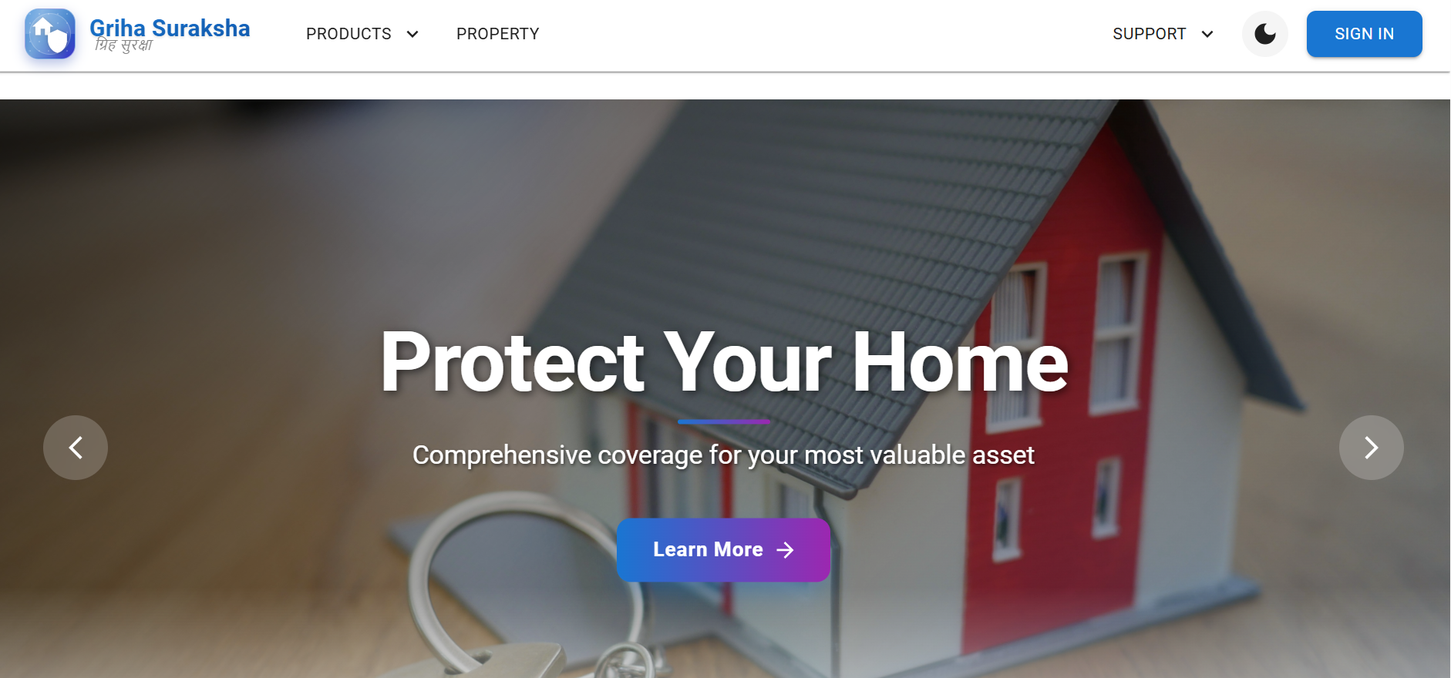
Home Page
It is a Main page of the Project

Slide 4
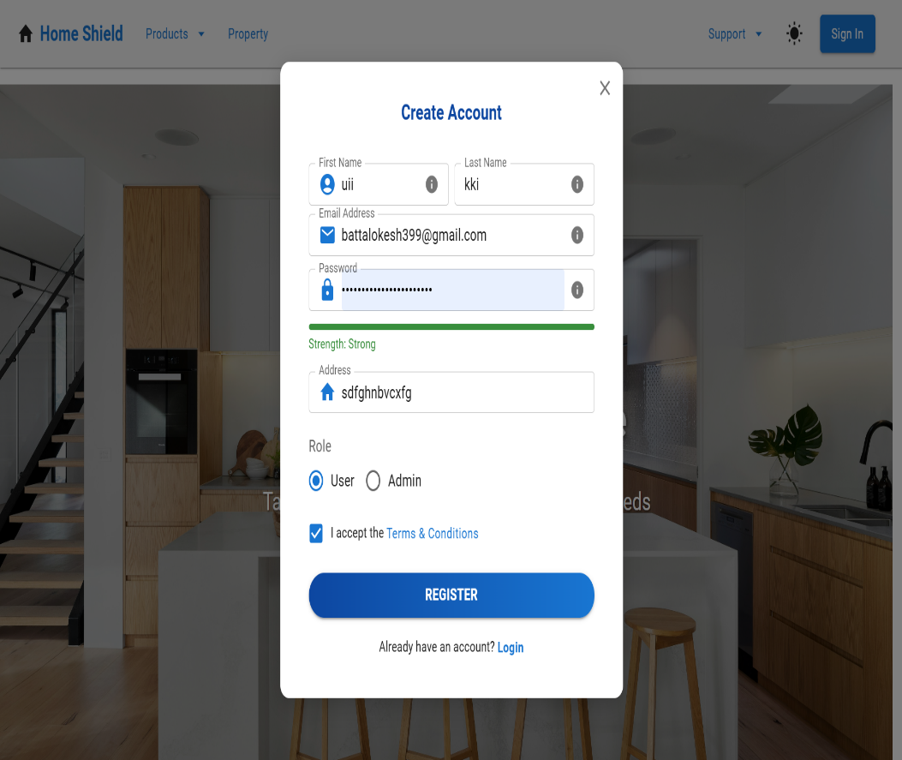
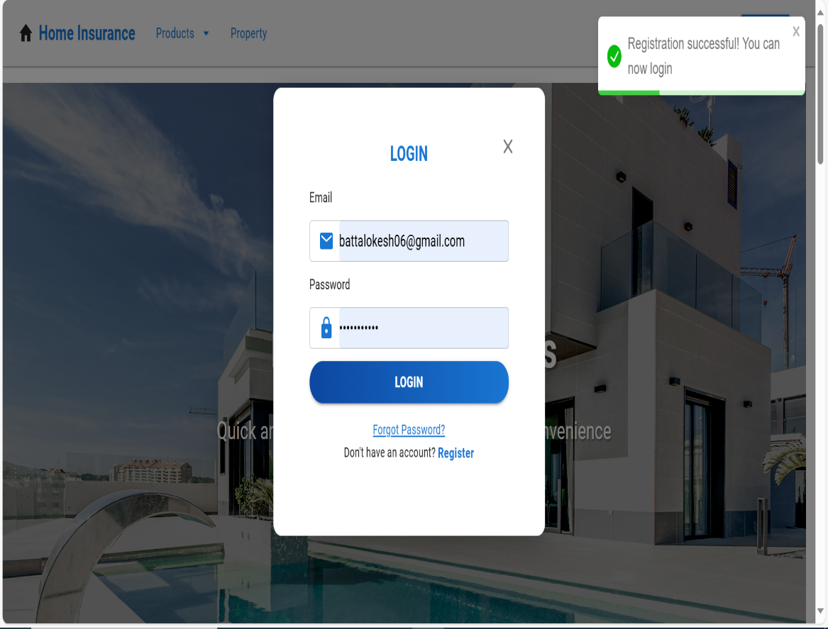
Register Page and Login page
→Customer first can Register Home Insurance page and provide all the credentials ,After fill Details he can click register button it will generate popup message registration successful
→After registration need to login for more features

Slide 5
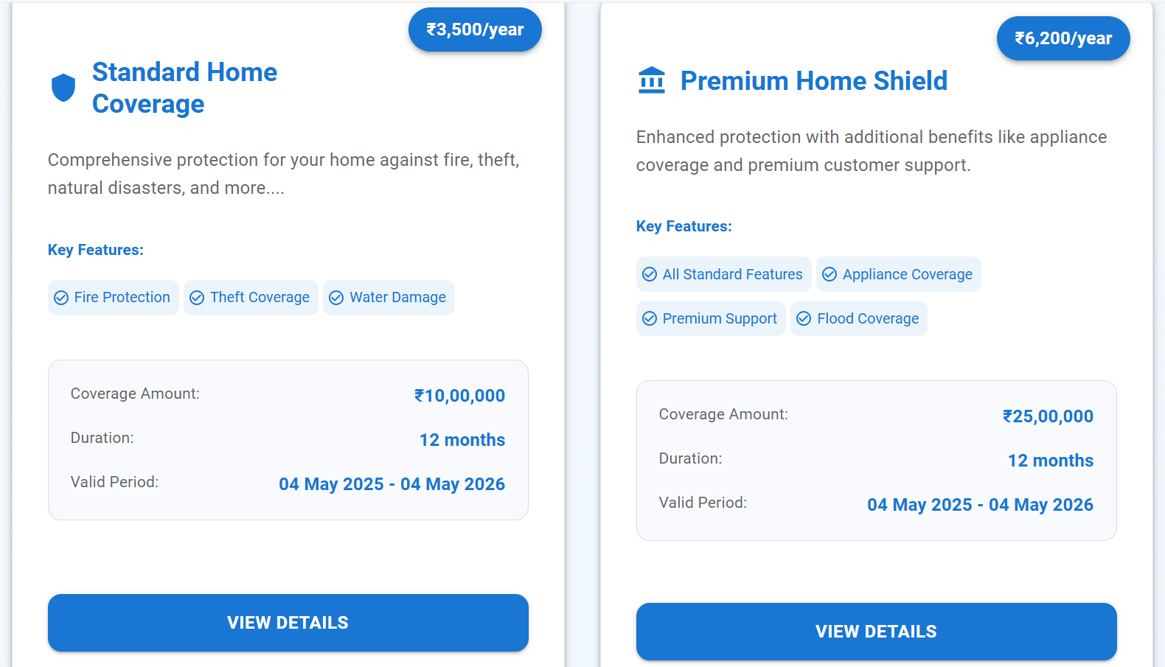
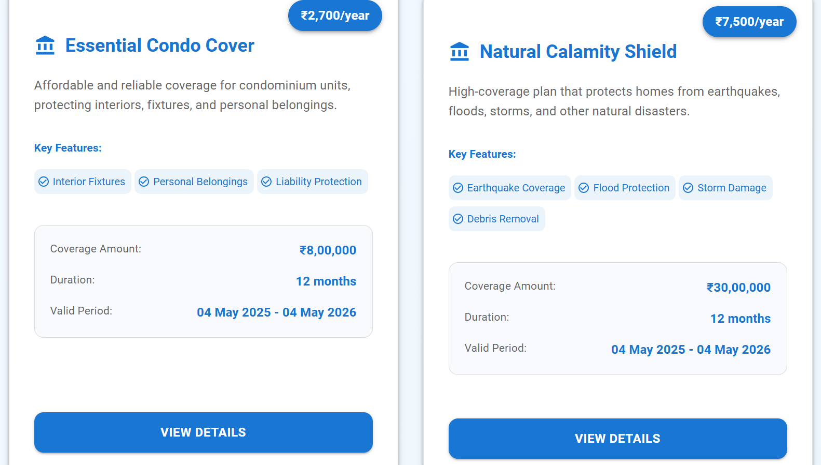
We have four Different policies user can choose best as per his/her Wish

Slide 6
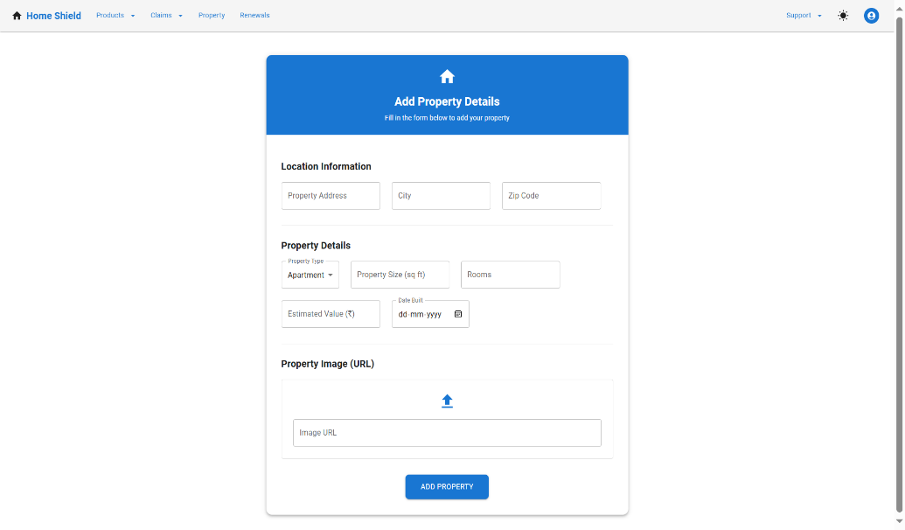
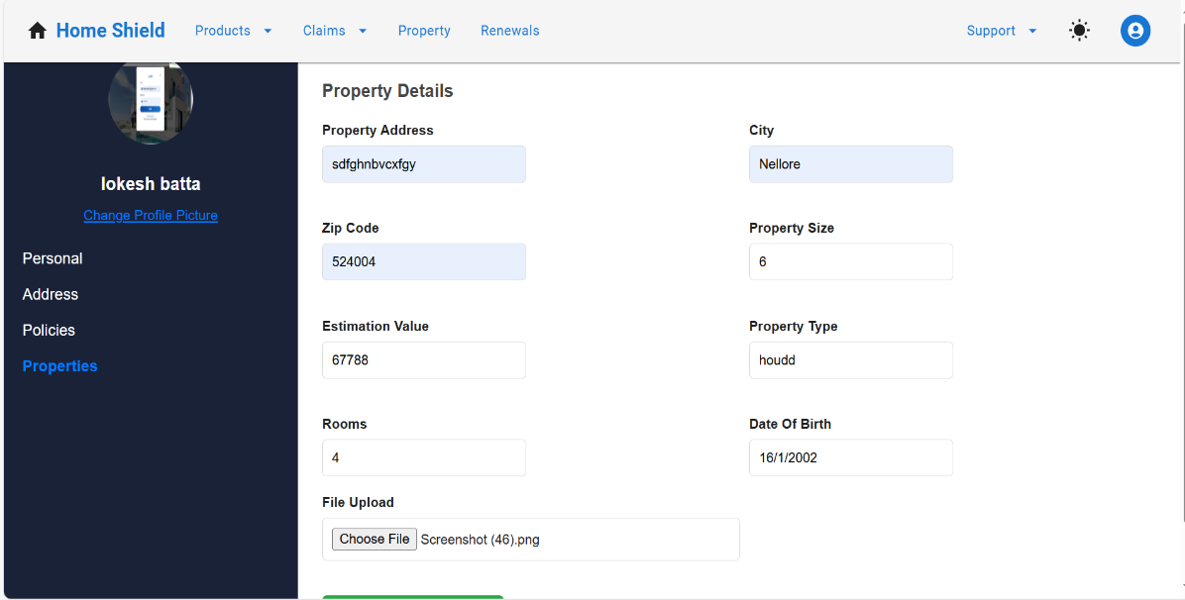
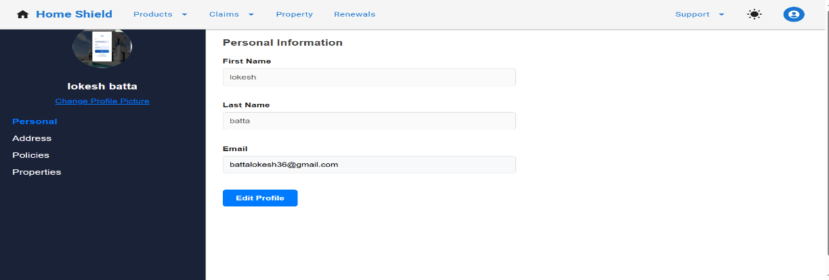
Add Property and Update User Details
Add property and as a user can be change details we can use with update profile like personal details, address , policies ,properties can be change

Slide 7
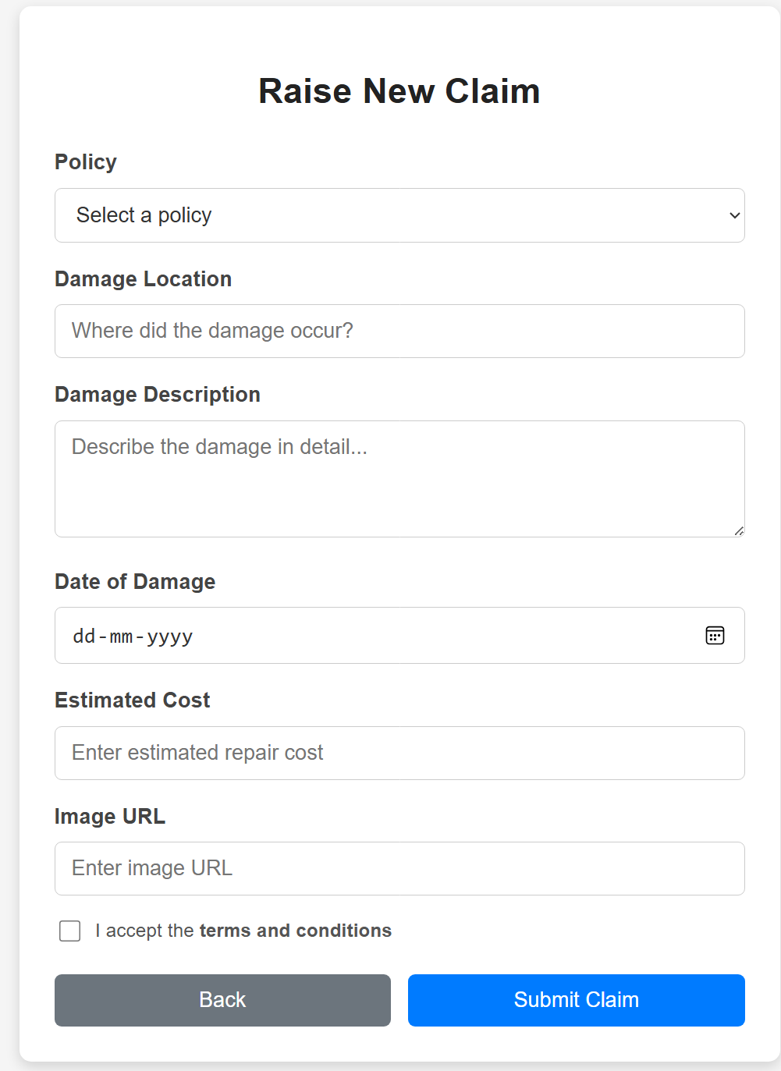
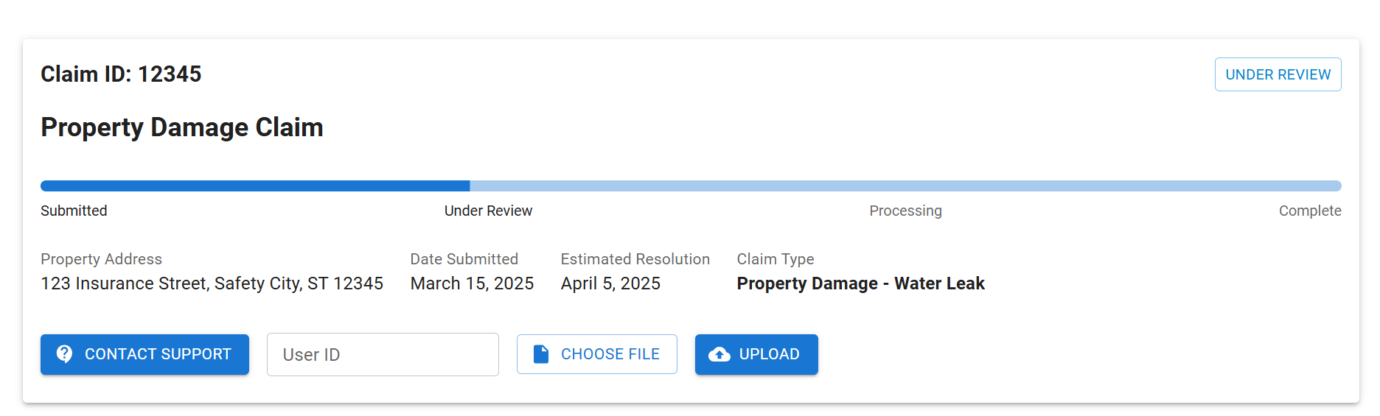
Rise and ClaImS TRACK
If user want to rise a claim he need to apply the claim and also he can track the claim

Slide 8
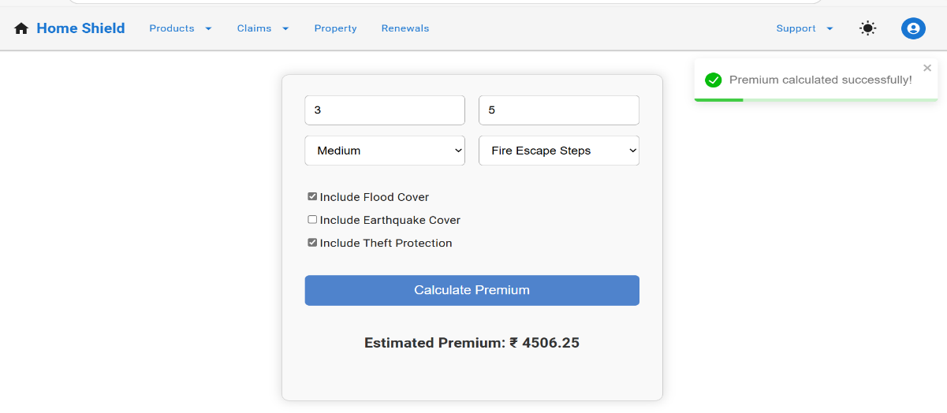
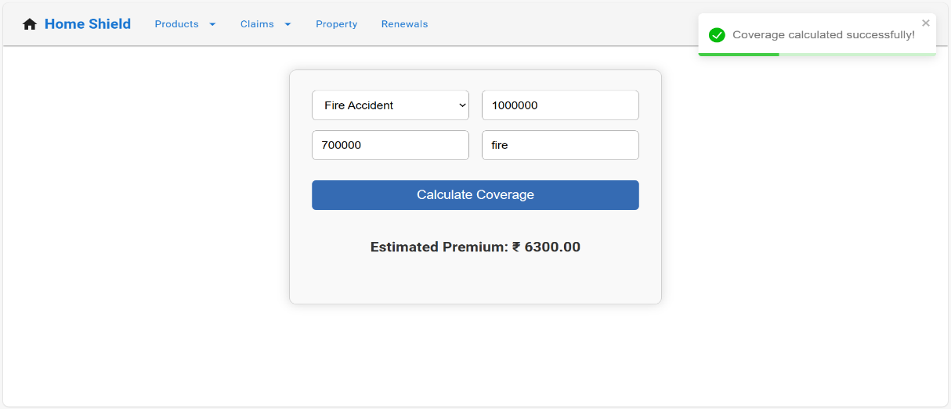
Premium And Coverage
How can calculate premium amount based on estimate amount and also coverage amount

Slide 9
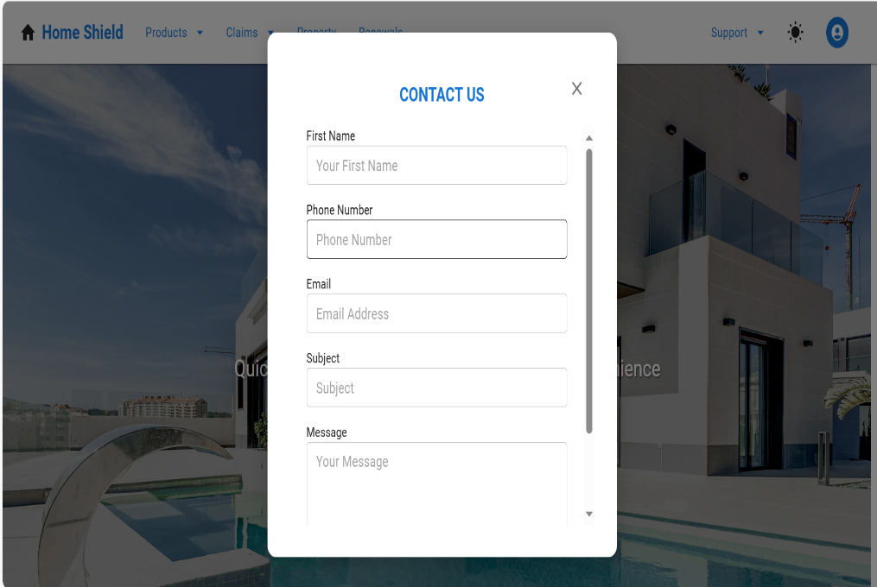
Contact us Chat support with customer
Users can ask questions about policy coverage, premium amounts, renewal dates, or claim processes.
if users face issues logging in, uploading documents, or making payments, they can get immediate support.

Slide 10
Technologies used in Home Insurance project
Frontend(React)
React js -Component-based UI
Axios – HTTP client for API calls
Material-UI(MUI)- UI component
React Hook Form – Form handling and validation
React Router – routing
Toastify – used in notifications
Backend (Spring boot)
Spring Boot – java –based backend frame work
Spring data jpa – ORM for Database operations( it can be connect database)
Spring Security and JWT Token – Authentication and authorization
Lombok – Reduces boilerplate code ( generate getters and setters and constructors)
Data Base and other tools
Postgres SQL – for relational data base
Postman –API testing

Slide 11
Thank you

